Slide 1

Rosemount PRO Radar Tank Gauge

Slide 2
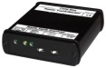
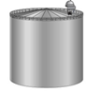
TR PRO -series
Features
10 GHz FMCW
Fast measuring speed, 10 Hz
TÜV Overfill approved
4 wire
2 bus, 2 power

Slide 3
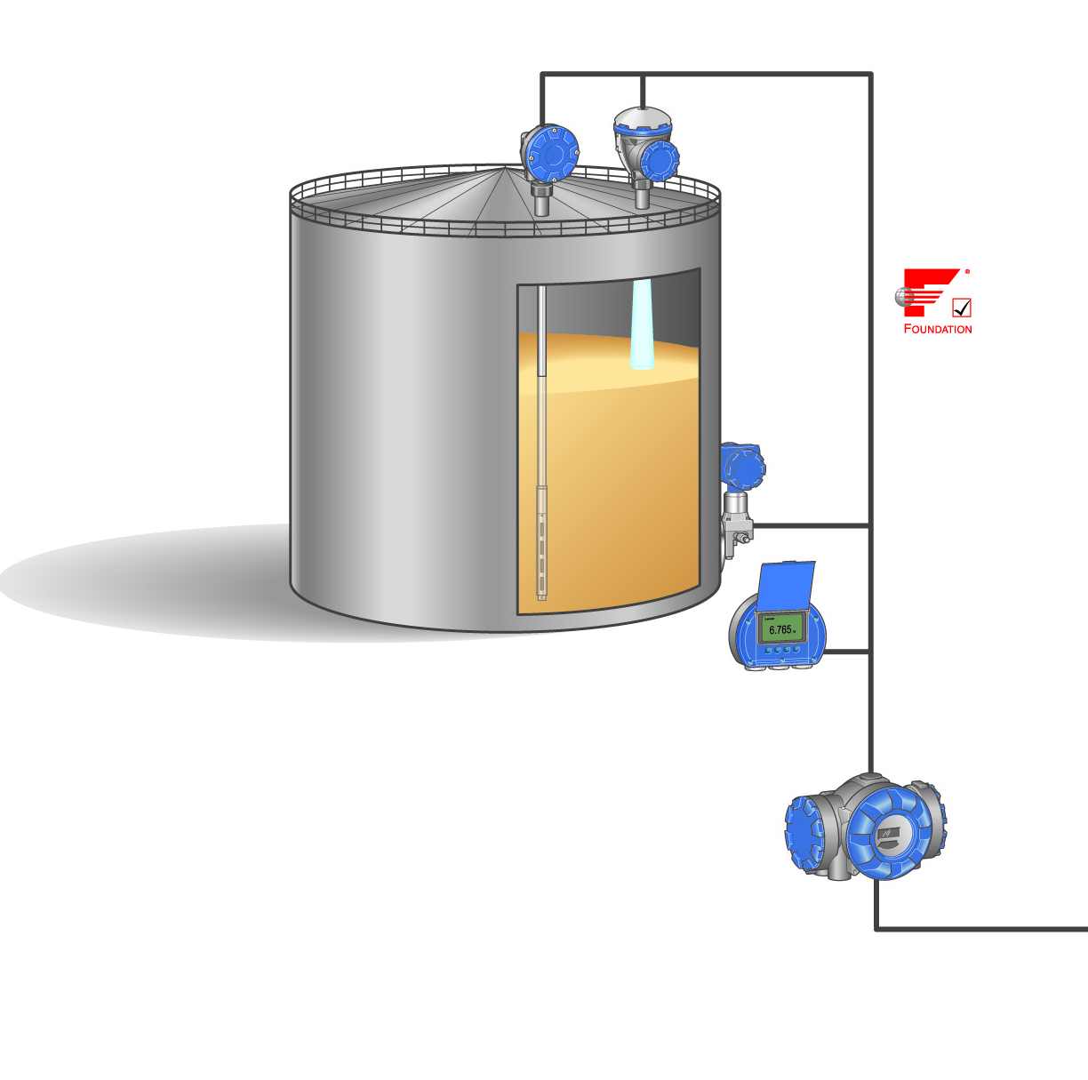
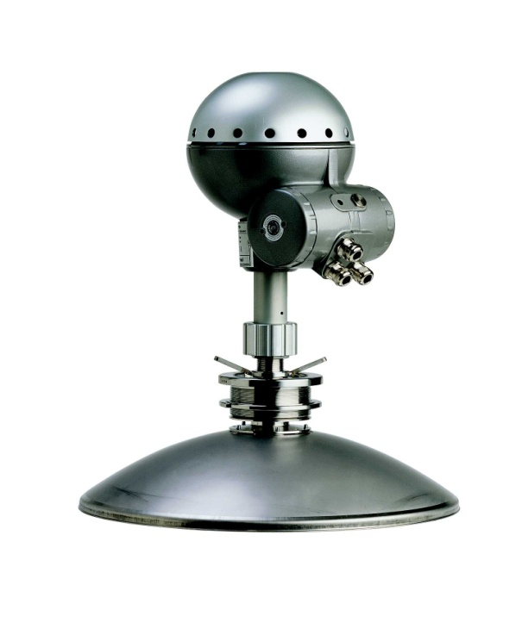
PRO Specifications
Instrument accuracy
±3 mm (0.1 in.)
Temperature stability in temp range ± 500 ppm of measured distance within -40 to +70 °C (-40 to +158 °F)

Slide 4
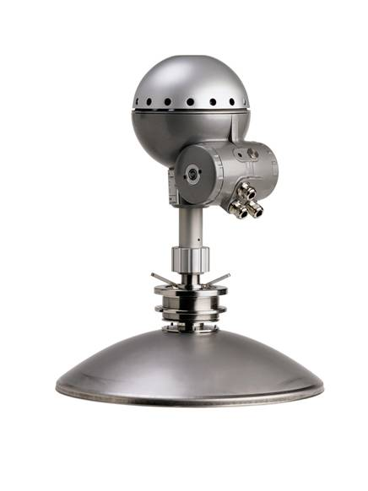
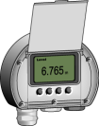

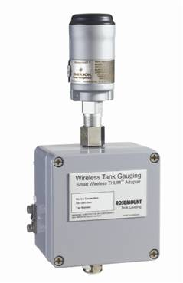
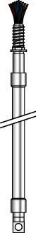
PRO Inputs and Outputs
Input
Output
Temp input card
in DU 2210
DU 2210
THUM
Communication bus
Rosemount TRL/2
Foundation Fieldbus
Profibus DP
RS-485
Temp
sensors
6 spots
Secondary 4-20 mA

Slide 5
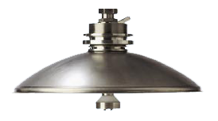
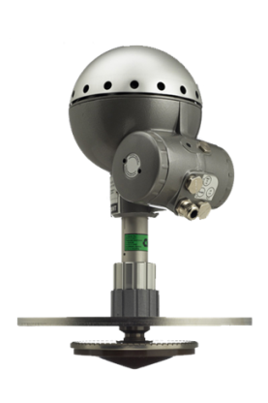
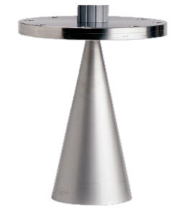
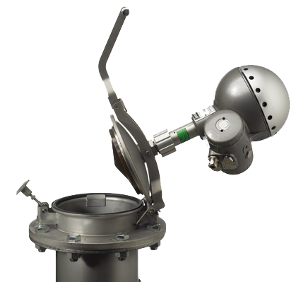
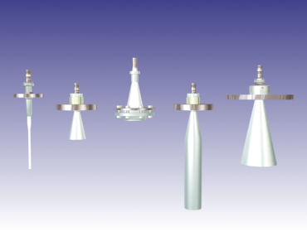
PRO Antennas
Parabolic Antenna | Cone Antenna | Still-pipe Array Antenna
Additional Antennas
Teflon Rod – long and short version
Various Cones – 2 to 8 inch. Coating and special steel as Titanium, Hastaloy avaliable on request
Process Seal – Ceramic or Teflon window, 4 to 6 inch
Still-pipe cone

Slide 6
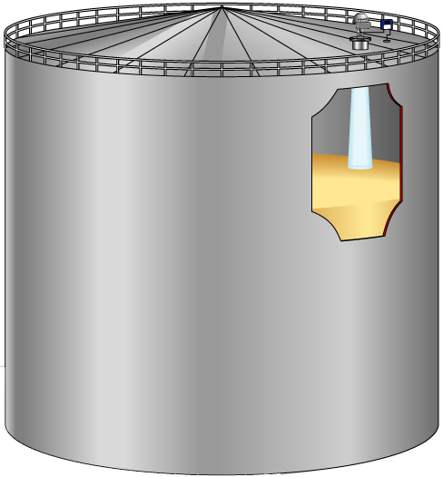
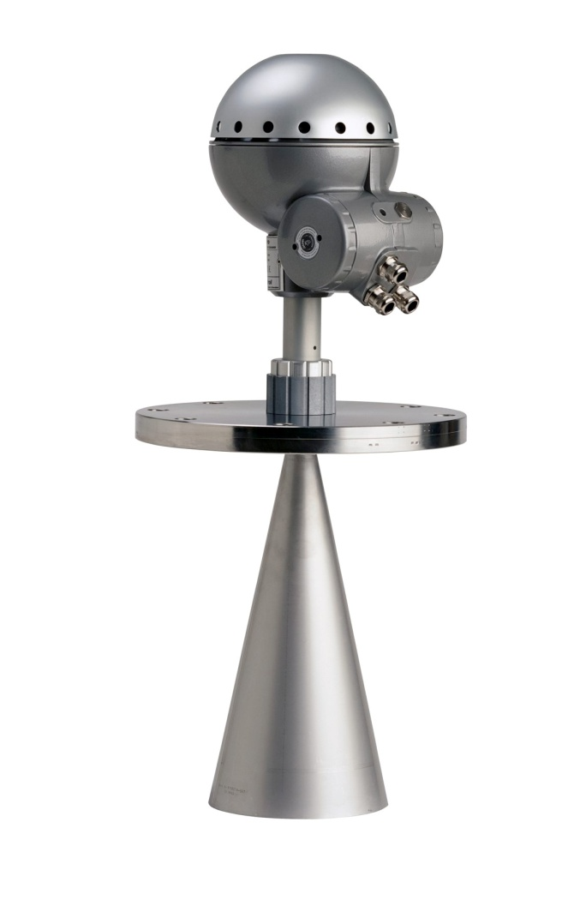
Cone Antenna
Designed for fixed roof tanks
Measuring range 0.4 ~ 15 m
Longer range possible but with reduced accuracy
Pressure up to 55 bar
2, 3, 4, 6, & 8” Antennas

Slide 7
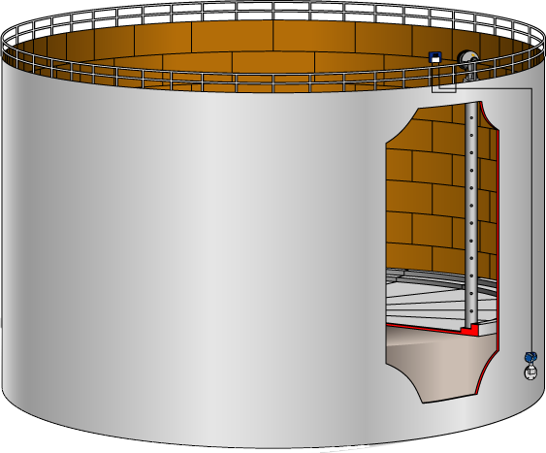
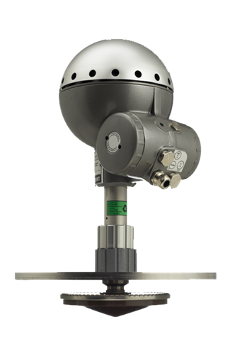
Still-pipe Array Antenna
Designed for still-pipe installations
Measuring range
0.8 to 40 m (2.6 to 130 ft) from end antenna
For longer measuring range, consult Rosemount repr.
Nozzle / antenna
For 5-, 6-, 8-, 10-, and 12-inch still-pipes. For smaller still-pipe, use 1- or 2-inch still-pipe antennas

Slide 8
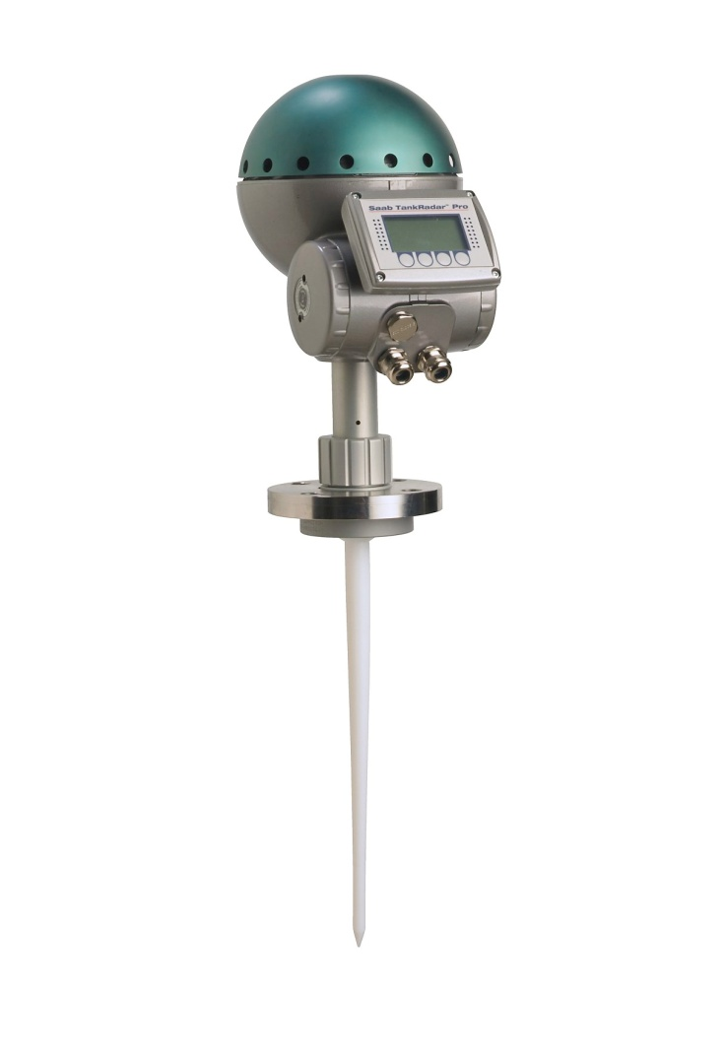
Rod Antenna
Suitable for small nozzles / tanks
Made of stainless steel and PTFE (teflon)
Available in / with
Two lengths: 400 mm and 550 mm, with 300 mm active part
Flange or threaded tank connection
Withstands high pressure
For 1.5 – 4 in. tank connections
± 5 mm (± 0.2 in. ) instrument accuracy

Slide 9
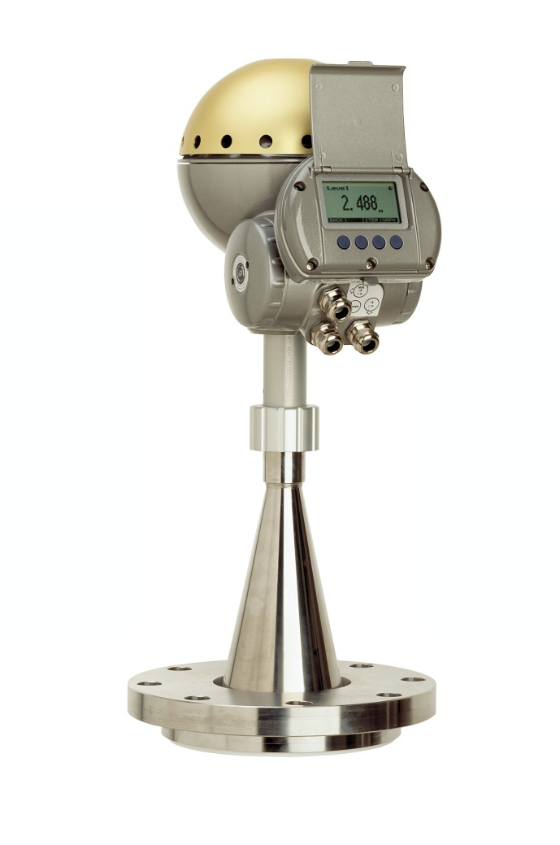
Process Seal Antenna
Suitable in hygienic or aggressive tank atmospheres
Cone antenna protected from the tank atmosphere by a ceramic or PTFE sealing
Ceramic seal withstands high pressures and temperatures
4- and 6-in. versions
4-in. version for hazardous applications
± 10 mm (± 0.4 in.) accuracy

Slide 10
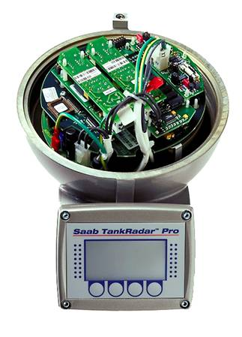
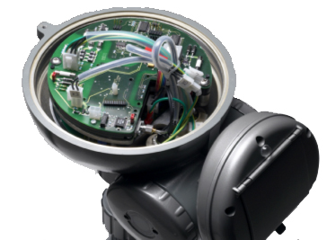
The electronics
Two versions of THE in PRO gauge
RTG40 RTG40B, 2002 ->

Slide 11
Features of RTG40B
Increased temperature stability.
Better than ±2 ppm/°K
Increased instrument accuracy
New power supply with ultra wide input range 24-260 Volt DC or AC (only one version).
Increased measuring speed, 10Hz as default, adjustable up to 20Hz for shorter ranges.
Built in Intrinsically safe active or passive 4-20mA HART output, always included.
Built in Intrinsically safe display interface, always included.
New intelligent 2210 Display Unit, replaces RDU40.
Fast reprogramming and configuration with high speed communication (38400 baud) via the sensor bus.

Slide 12
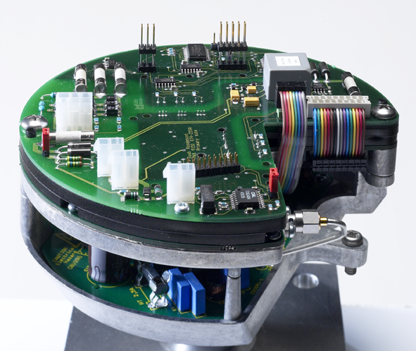
THE
TA 43
TGE
PS 43
MicroWave output

Slide 13
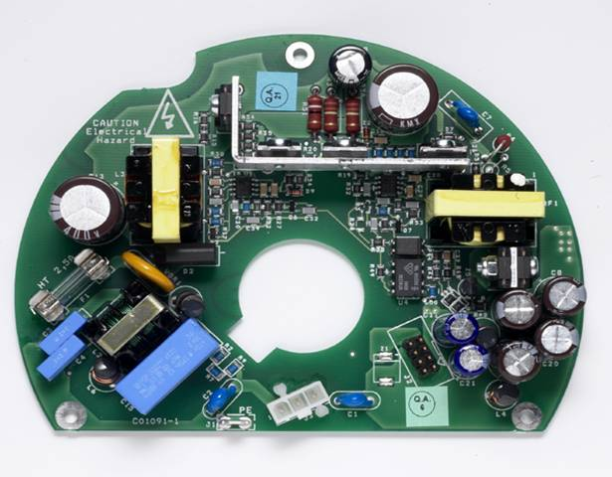
PS 43
24-260Volt
0-60Hz
No selection
Output: +5 VDC +12 VDC
Max 10 W
Typical < 5W

Slide 14
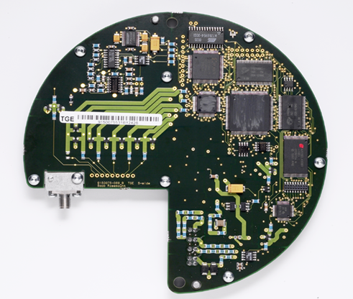
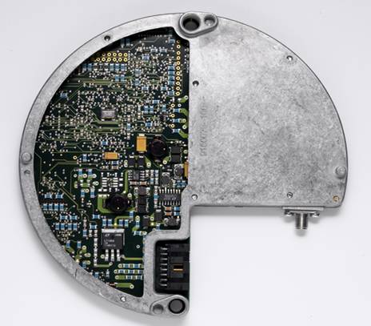
TGE (main board)
Service LED
Microwave module
Microwave output (coax)

Slide 15
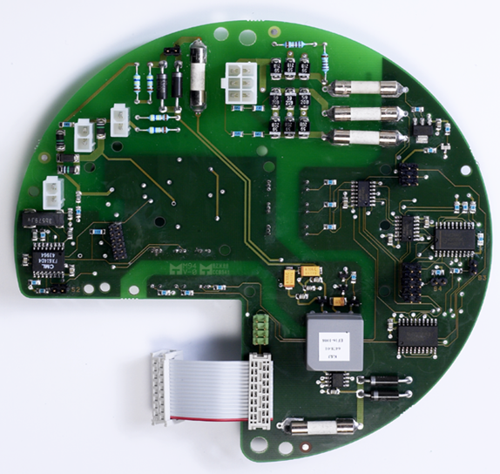
TA 43
Active 4-20 Hart
Display Interface
Passive 4-20 HART
Power LED
Foundation Fieldbus
Area for optional TM40, FF43, XA40, AA40

Slide 16
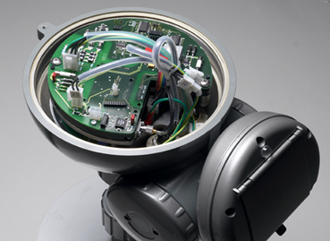
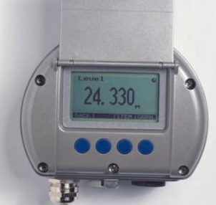
Display Unit
RTG40B requires 2210 DU
New communication interface
RS-485
TankRadar Pro RTG40B
2210 Display Unit

Slide 17
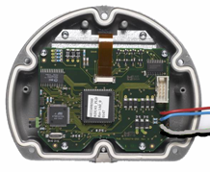
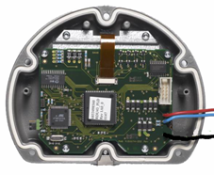
2210 DU vs RDU40
2210 DU for PRO RTG40B
New processor board (RB 43 )
Connection with 4 wires
Red +5VDC
Blue DP DA
Gray DP DB
Black IS Ground
RDU40 for REX and Old PRO
Processor board (RB 40 )
Connection with 3 wires
Red DP+
Blue DPS
Black IS Ground

Slide 18
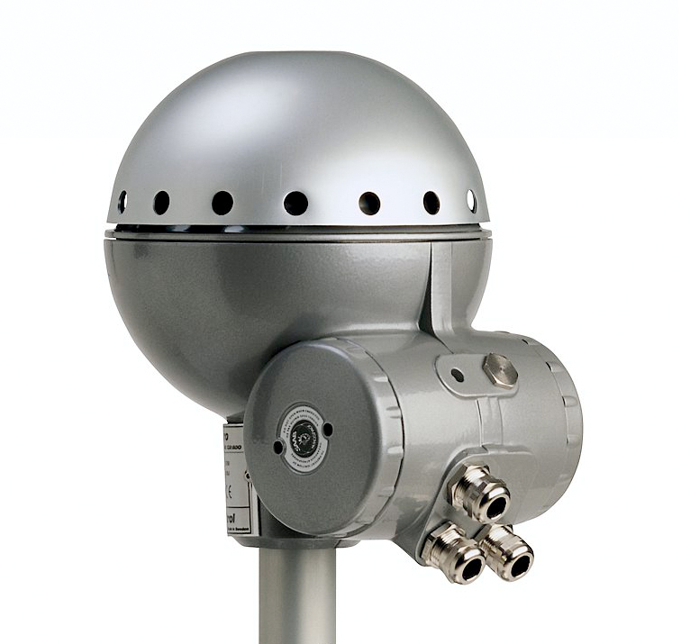
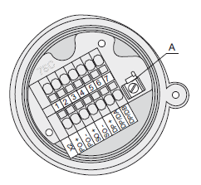
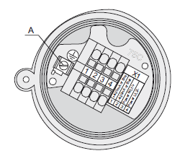
Terminal Block
Integrated junction box sockets for
Non-intrinsically Safe Junction Box – EEx e
1-2: Non IS HART/4-20 mA primary analog output, or TRL/2 Bus, Profibus DP or IS Foundation fieldbus
3-4: Power supply input
Intrinsically Safe Junction Box – EEx i
1-2: ISHART /4-20 mA primary analog out or IS Foundation Fieldbus
3-4: Secondary analog output
5-7: Display unit
A: Ground terminal for Display Unit
EEx e
X11 Eex i

Slide 19
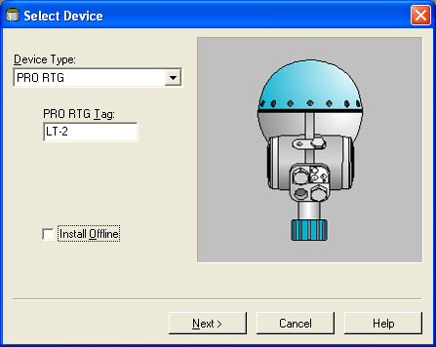
Configuration
Configuration tools
TankMaster WinSetup

Slide 20
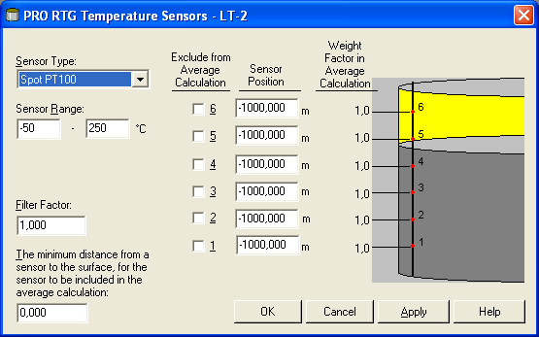
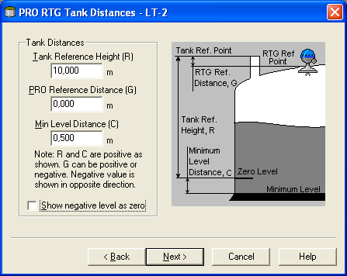
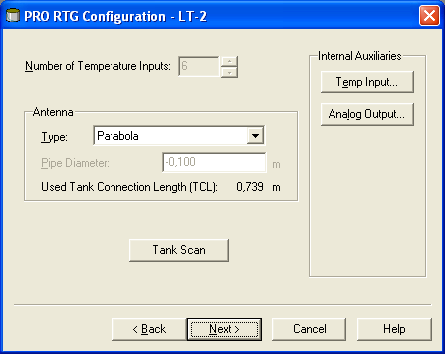
Basic Configuration
RTG Configuration
Antenna type, (pipe ID, temperature, analog out)
Tank Distances
Tank Ref height
PRO Ref distance
Tank Geometry
hold off distance, calibration distance

Slide 21
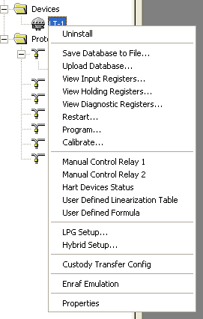
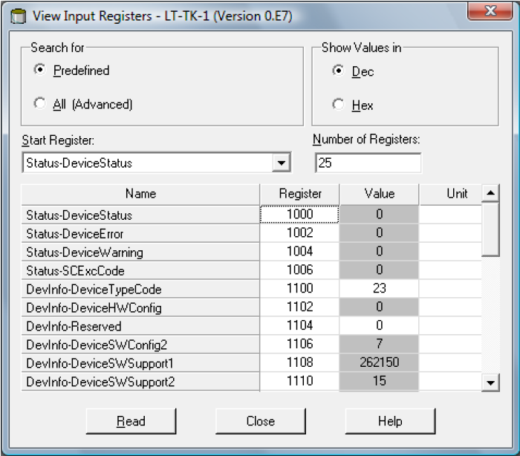
Holding & Input Reg
Holding Register
Stores various parameters, configuration data
Edit by typing in new value or change separate bits(bitfield)
Input Register
Stores transmitter data

Slide 22
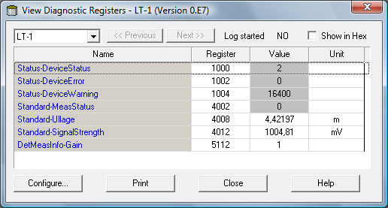
Diagnostics
Pre-defined selection of database registers for an instant view of the device status
Read only
Loaded from the device as the window is opened
Grey background if more information (Bitfield or ENUM)
Hexadecimal possible
Configure button
Change the list of registers to be displayed
Possible to log registers

Slide 23
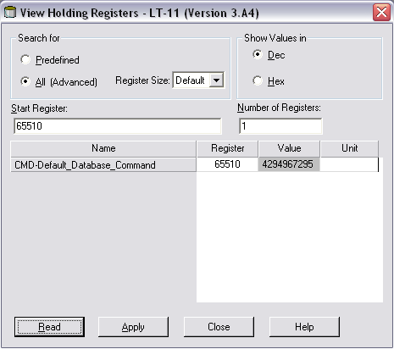
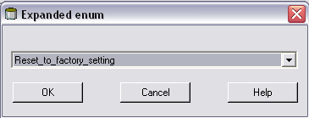
Default Load
View Holding Register
All (advanced)
65510
Read data
Reset to factory settings
Click the Apply button

